Slide 1

The Development of Modularity in Neural Networks
Project CS299R Harvard IACS 2021
Dan Cox
Notes:
Core Concept: How synaptic pruning shapes neural wiring during development and, possibly, in disease
Jill Sakai
PNAS

Slide 2
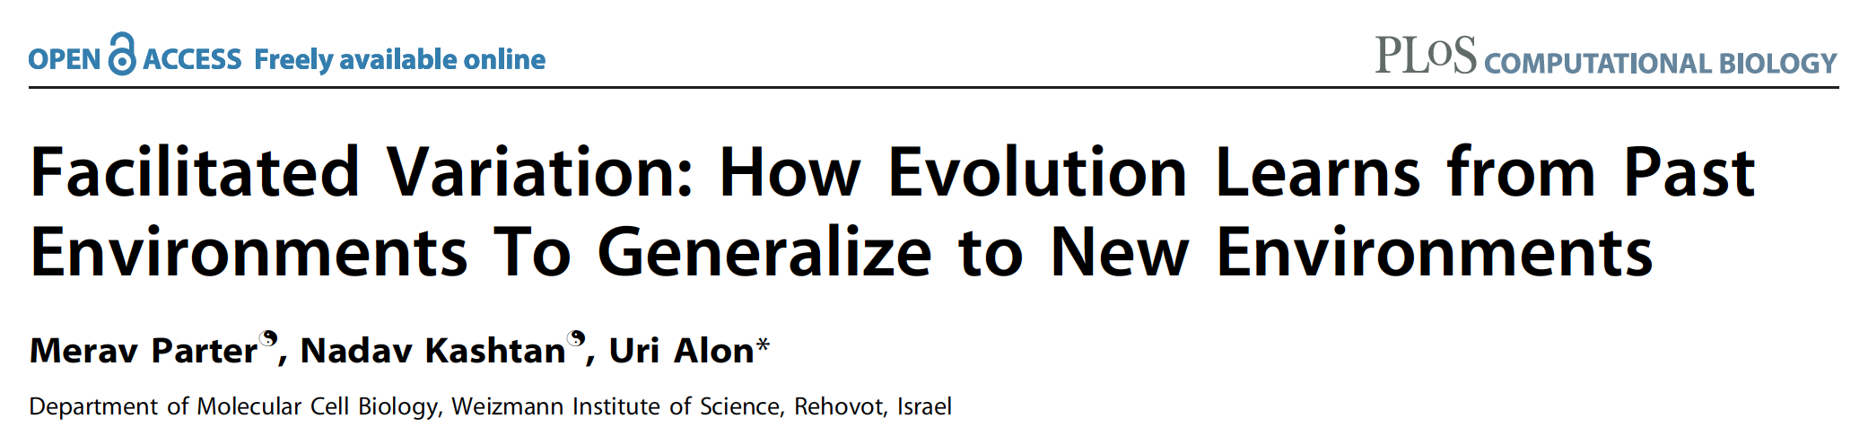
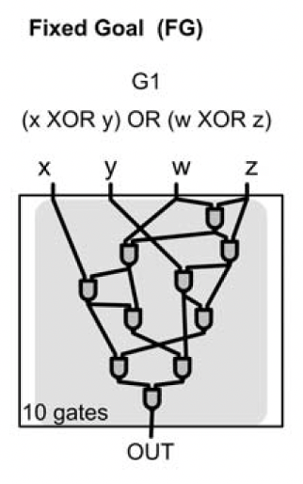
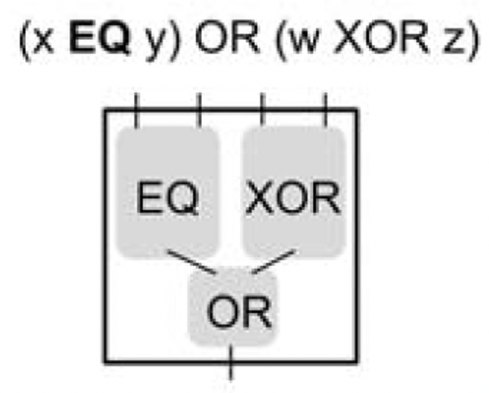
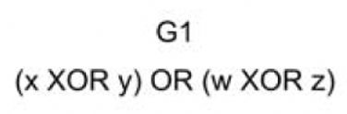
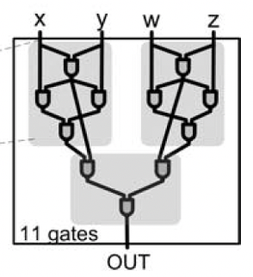
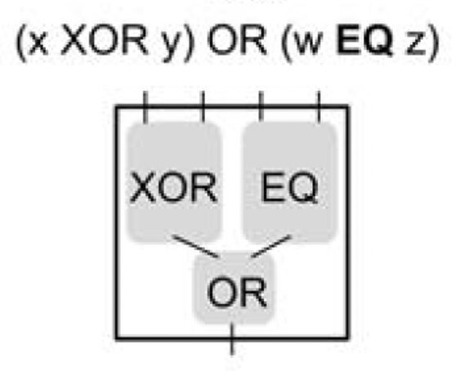
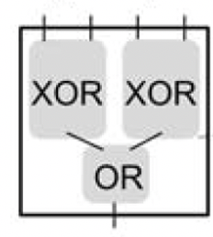
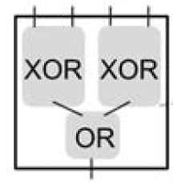
NAND
NAND
Notes:
Core Concept: How synaptic pruning shapes neural wiring during development and, possibly, in disease
Jill Sakai
PNAS

Slide 3
Conclusions
Modular systems naturally evolve when systems are evolving toward more than one goal.
When only a single goal is present, modularity does not arise.
Modularity becomes more pronounced when the series of goals the system evolves toward are themselves modular. That is, the latter goals can be thought of as a composite of the earlier goals.
Notes:
Core Concept: How synaptic pruning shapes neural wiring during development and, possibly, in disease
Jill Sakai
PNAS

Slide 4
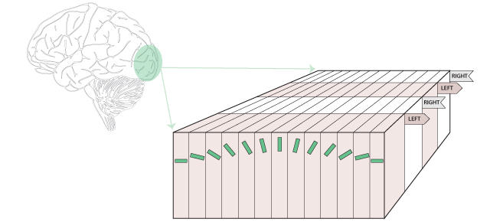
Neural systems are modular
The visual cortex is organized
into functional maps of:
Orientation,
Spatial frequency
Ocular dominance
Temporal frequency .
Notes:
Adaptation and Neuronal Network in Visual Cortex
By Lyes Bachatene, Vishal Bharmauria and Stéphane Molotchnikoff
Submitted: December 5th 2011Reviewed: April 17th 2012Published: September 26th 2012
DOI: 10.5772/46011

Slide 5
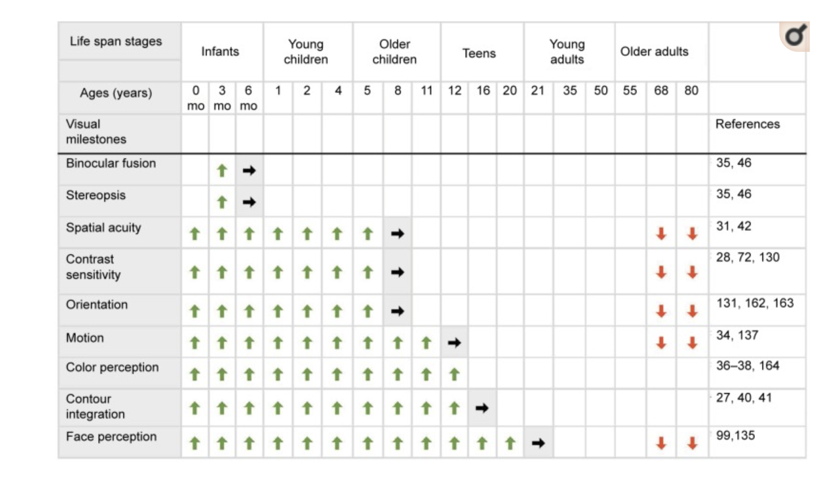
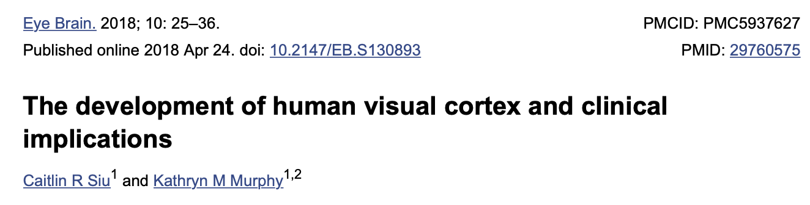
This modularity continues to develop after birth

Slide 6
Questions
Do neural networks also develop modularity naturally when they are trained on shifting goals but not on static goals?
If so, is modularity more profound if the goals they are trained on are also modular?
For my project I am addressing these questions using artificial neural networks.
Notes:
Core Concept: How synaptic pruning shapes neural wiring during development and, possibly, in disease
Jill Sakai
PNAS

Slide 7
Project Plan
Create a series of artificial feedforward multilayered neural networks.
Train the networks to classify images with a either a single goal or a series of shifting goals.
Assess the performances of the neural networks, and compute their modularity.
Repeat similar experiments while varying:
Network architecture
Degree of pruning
Notes:
Core Concept: How synaptic pruning shapes neural wiring during development and, possibly, in disease
Jill Sakai
PNAS

Slide 8
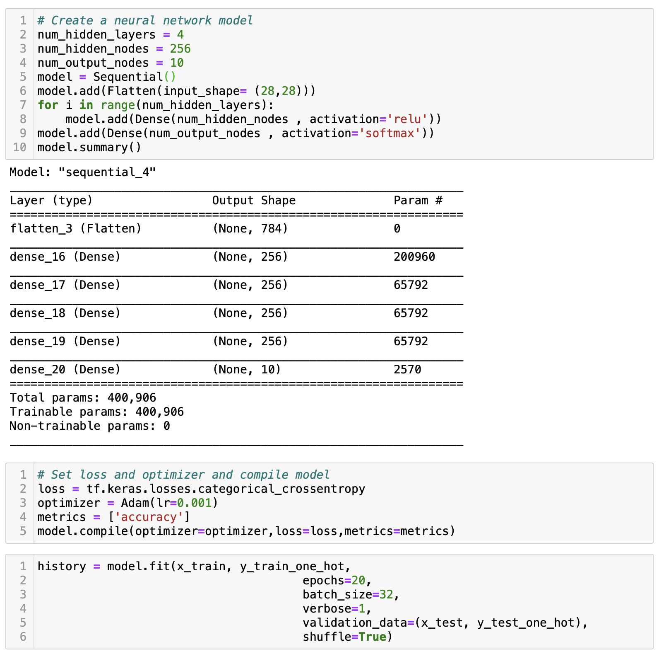
Create a series of artificial feedforward multilayered neural networks.
Python, Keras, Tensorflow
Notes:
Core Concept: How synaptic pruning shapes neural wiring during development and, possibly, in disease
Jill Sakai
PNAS

Slide 9
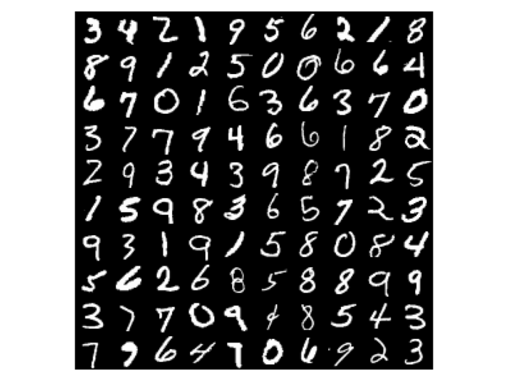
II. Train the networks to classify images with a either a single goal or a series of shifting goals.
MNIST
Example: (2, 3, 8, 9)
Single Goal:
Train network to identify these 4 numerals from 0 – 9 all at once.
Shifting Goals:
Train network to identify:
2 from all others, then
3 from all others, then
8 from all others, then
9 from all others
Example: (2, 4, 6, 7)
Notes:
Core Concept: How synaptic pruning shapes neural wiring during development and, possibly, in disease
Jill Sakai
PNAS

Slide 10
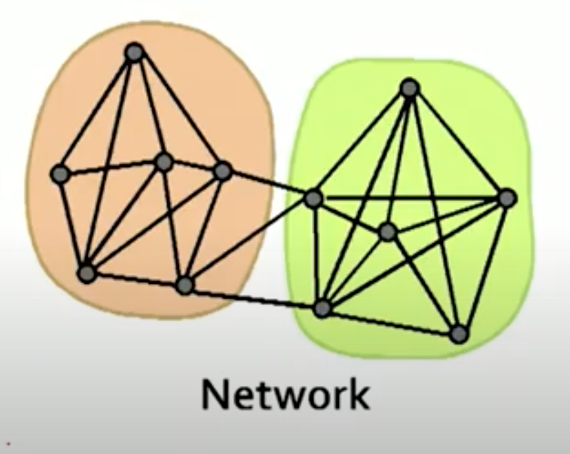
III. Assess the performances of the neural networks, and compute their modularity.
Perfomance
Accuracy = Fraction Correct
Modularity
Spectral Graph Partitioning -> n-cut
Filan, D., et al., arXiv, 2020. 2003.04881v4: p. 1 - 24.
Notes:
Core Concept: How synaptic pruning shapes neural wiring during development and, possibly, in disease
Jill Sakai
PNAS

Slide 11
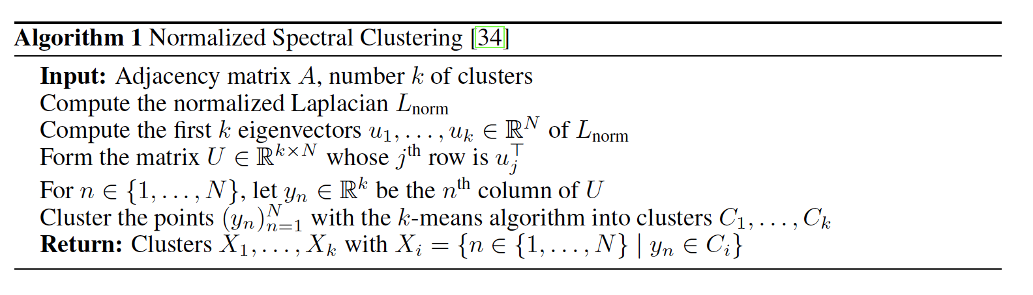
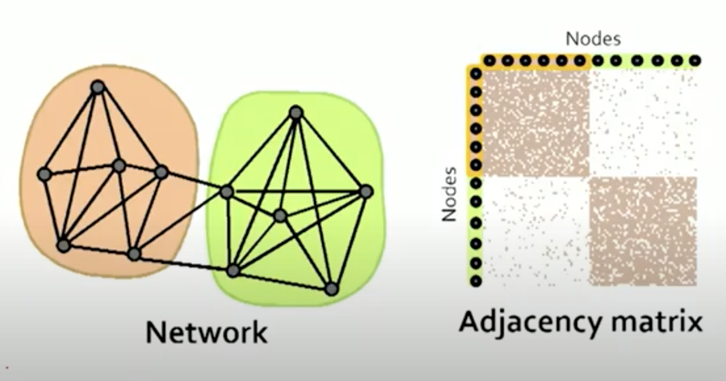
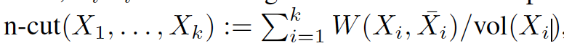
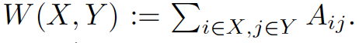
III. Assess the performances of the neural networks, and compute their modularity.
the weight between two disjoint sets of neurons X; Y
With this metric a network is more modular when neurons in the same partition share strong synaptic weights with each other and weak synaptic weights with neurons in different partitions.
Notes:
Core Concept: How synaptic pruning shapes neural wiring during development and, possibly, in disease
Jill Sakai
PNAS

Slide 12
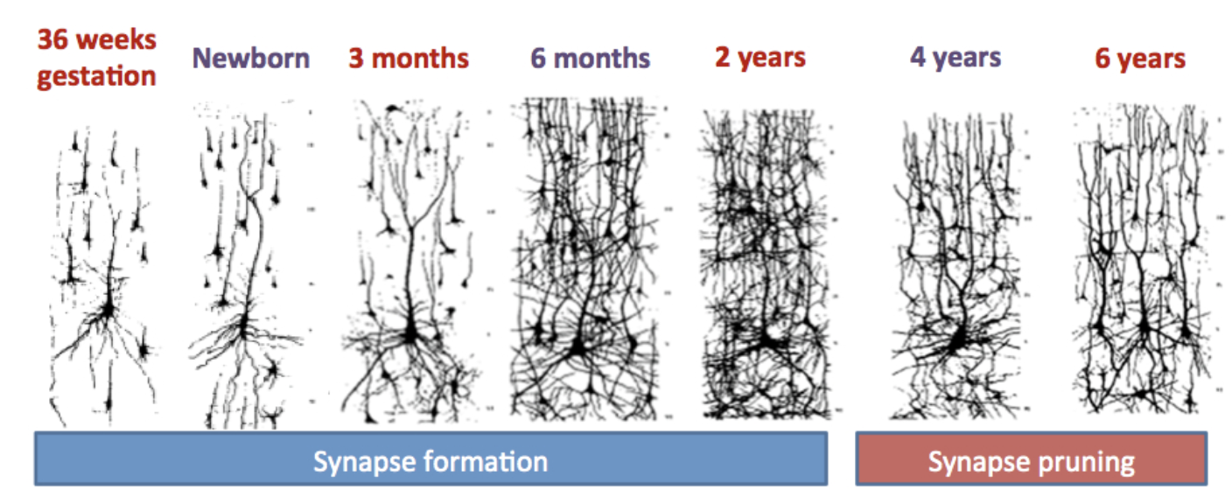
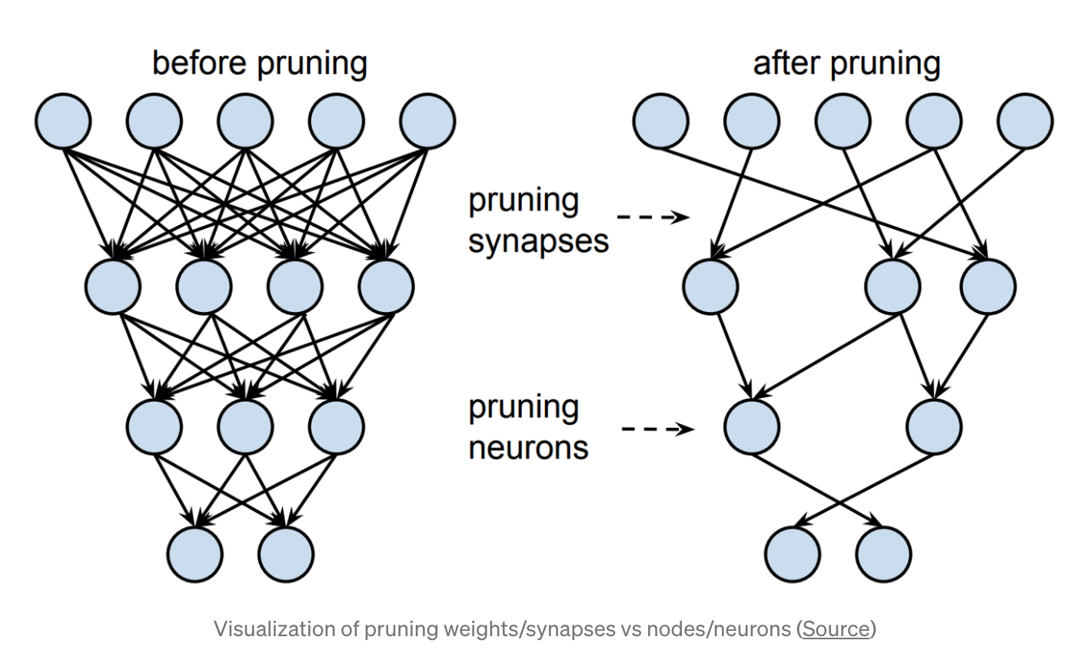
Repeat similar experiments while varying:
Network architecture
Degree of pruning
Notes:
Core Concept: How synaptic pruning shapes neural wiring during development and, possibly, in disease
Jill Sakai
PNAS

Slide 13
Repeat similar experiments while varying:
Network architecture
Degree of pruning
Notes:
Core Concept: How synaptic pruning shapes neural wiring during development and, possibly, in disease
Jill Sakai
PNAS

Slide 14
Expected Results
I expect to see networks with increasing modularity in the following order:
those trained on a static goal,
those trained on a shifting nonmodular series of goals,
those trained on a shifting modular series of goals.
Further, I expect pruning to enhance modularity and perhaps larger networks to be more modular than smaller ones.
Notes:
Core Concept: How synaptic pruning shapes neural wiring during development and, possibly, in disease
Jill Sakai
PNAS

Slide 15
Where am I
Checklist:
Write frunctions to manipulate MNIST Data
Create data series to use in experiments
Write code to implement Neural Networks (keras)
Figure out a way to shift goals mid training
Figure out a way to assess the accuracy of a network trained on shifting goals
Implement pruning during training.
Write code to extract a graph of the network and adjacency matrix
Implement spectral graph clustering/ n-cut algorithm to assess modularity
Run Experiments
Write up results
Notes:
Core Concept: How synaptic pruning shapes neural wiring during development and, possibly, in disease
Jill Sakai
PNAS

Slide 16

Where am I
Checklist:
Write frunctions to manipulate MNIST Data
Create data series to use in experiments
Write code to implement Neural Networks (keras)
Figure out a way to shift goals mid training
Figure out a way to assess the accuracy of a network trained on shifting goals
Implement pruning during training.
Write code to extract a graph of the network and adjaceny matrix
Implement n-cut algorithm to assess modularity
Run Experiments
Write up results
Notes:
Core Concept: How synaptic pruning shapes neural wiring during development and, possibly, in disease
Jill Sakai
PNAS

Slide 17
Demo
Notes:
Core Concept: How synaptic pruning shapes neural wiring during development and, possibly, in disease
Jill Sakai
PNAS

Slide 18
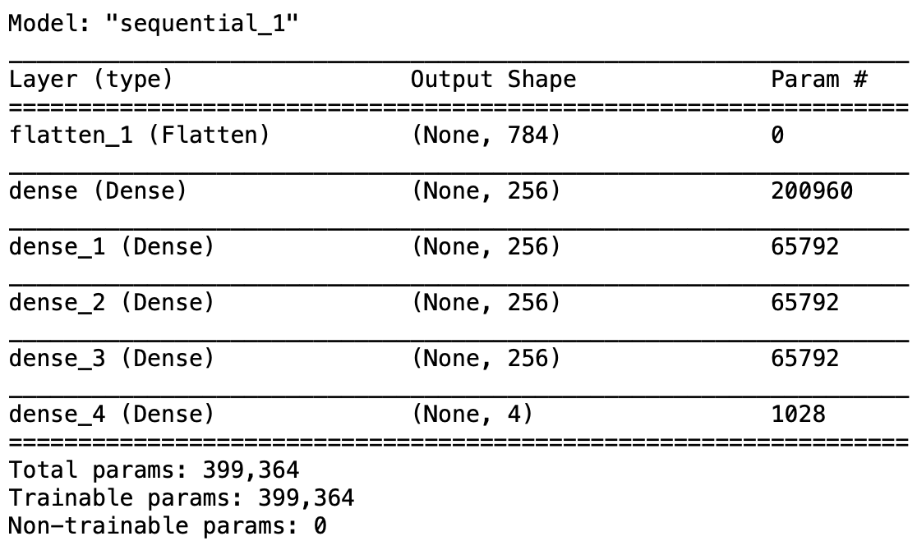
Notes:
Core Concept: How synaptic pruning shapes neural wiring during development and, possibly, in disease
Jill Sakai
PNAS

Slide 19
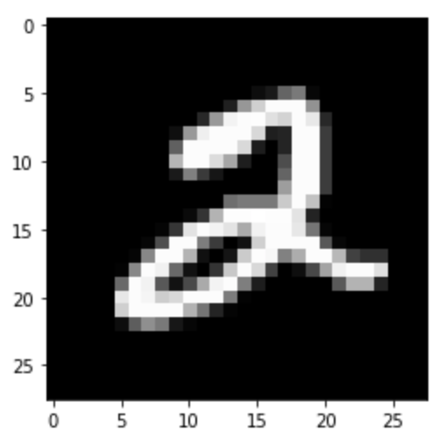
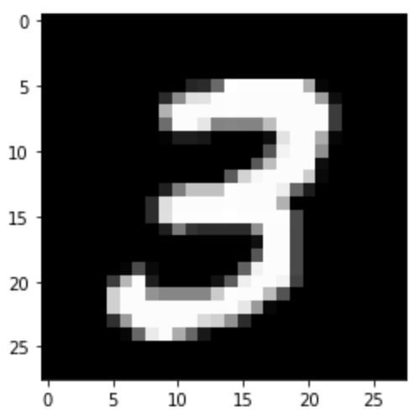
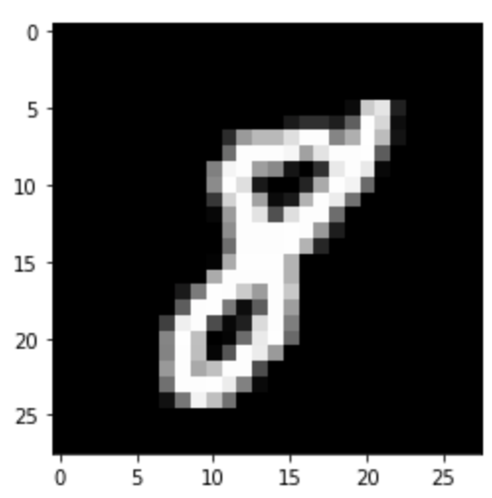
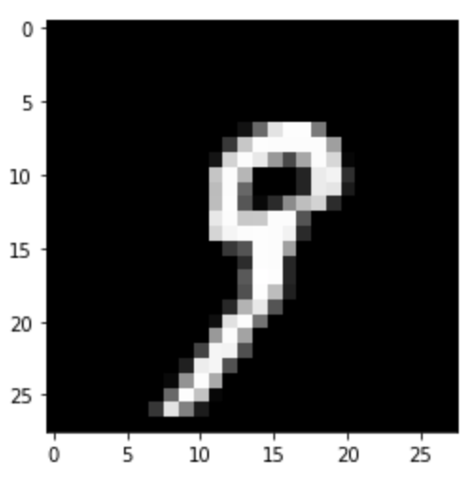
Notes:
Core Concept: How synaptic pruning shapes neural wiring during development and, possibly, in disease
Jill Sakai
PNAS

